Slide 1
Indian Travelling Guide
Industrial Training project……
By Naman Maheshwari
Section-A RollNo.-181500411

Slide 2
Objective
The objective is to develop a Front End Website about Indian tourism that briefly tells about main and important Indian destinations and give suggestions about hotel booking and vehicle booking sites and also include different payment features also.

Slide 3
Introduction
India is one of the oldest and rich civilizations in the World. From Himalayas in the North to Sky-touching temples in the south, There is immense possibility of tourism in India. If anybody want to travel in India, he should know some things like what are the important Destination in India and should know some online sites that offer booking hotel rooms or related to transport.
So in this project, I have made a Front-end website that will tells about the important destinations in India, and also give suggestions about the sites that book hotels, so you can pick best deals. It also give suggestion about the sites about transport, for ex. If you want to go by road so u can book ola cab or Uber cab. It has various payment methods like Google pay, Paytm, phonepe.

Slide 4
Software and Hardware Requirements
Hardware : PC or Laptop containing (i3 processor or above), RAM 4GB or more and Hard Disk 500GB or above)
Software: Window 7/8/10
VS code
Github
Google chrome

Slide 5
Technology Used
HTML : It is used by developers to define structure of the webpage. Every page you see on browser is written using HTML. Web-Browser read and understand the markup text in HTML.
CSS : CSS stands for Cascading Style Sheets. To define style of the Web Page that is, type of font, its size, background-color etc. ,we use CSS. Using CSS, you can define, how each element of your web-page should look. Browser read HTML and CSS together to define the web page.
In this Project, we Use External style sheets named file as “ travel.css”

Slide 6
SCREENSHOTS
FROM THE WEBSITES

Slide 7
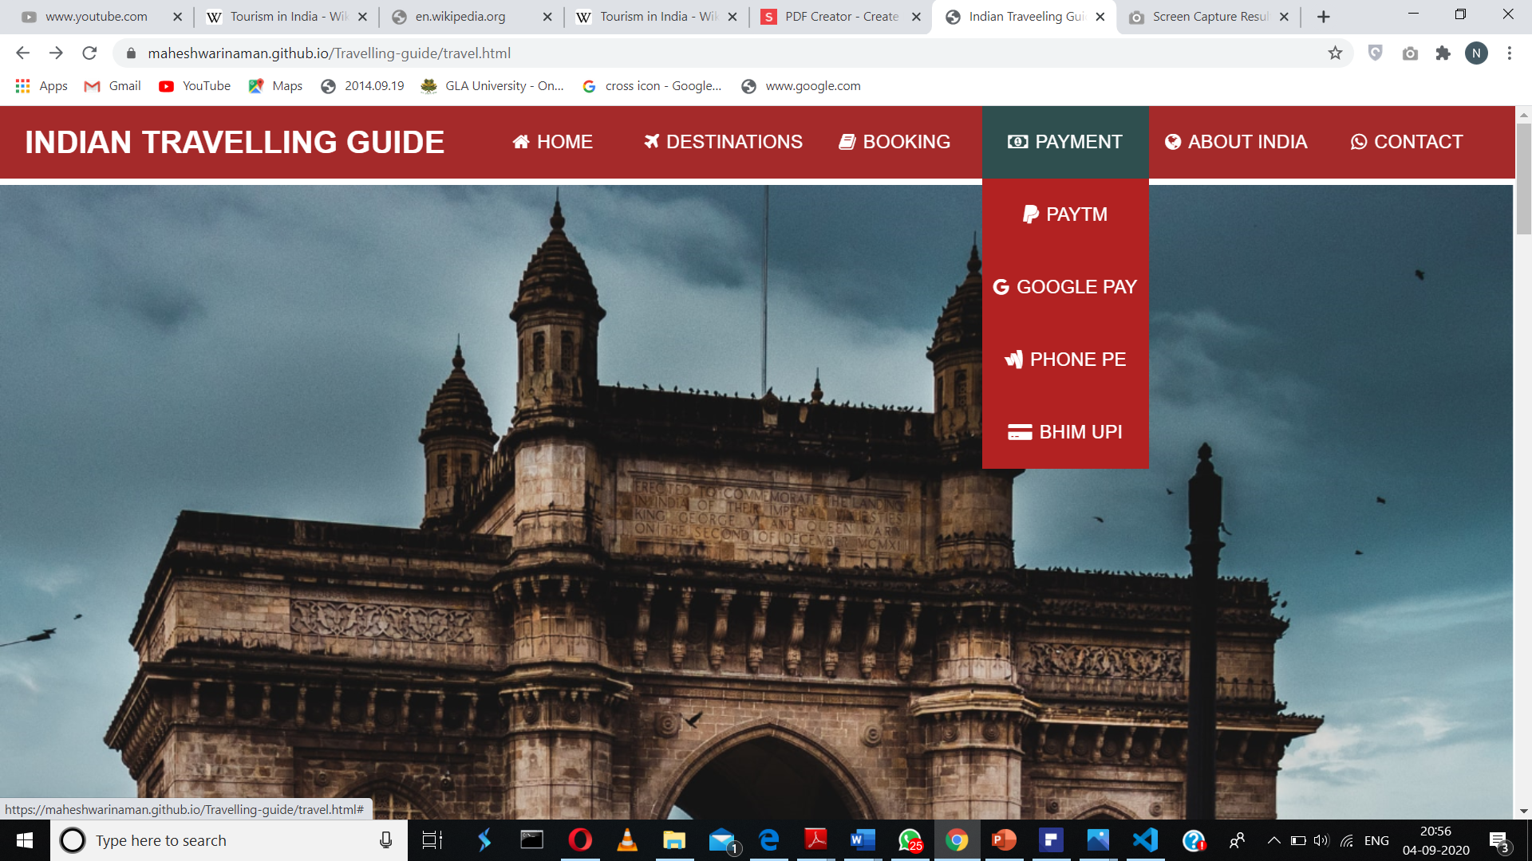

Slide 8
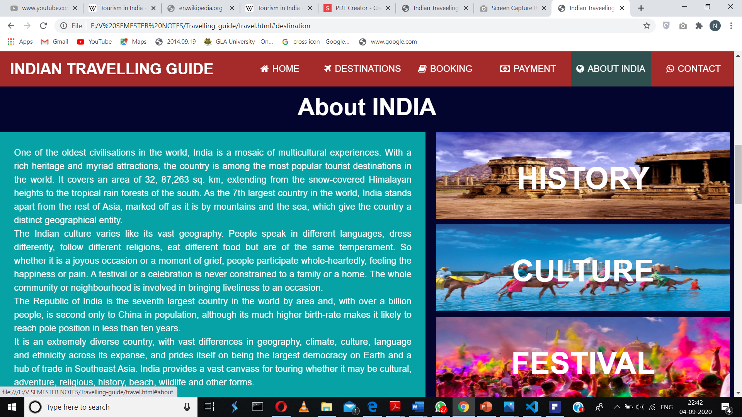

Slide 9
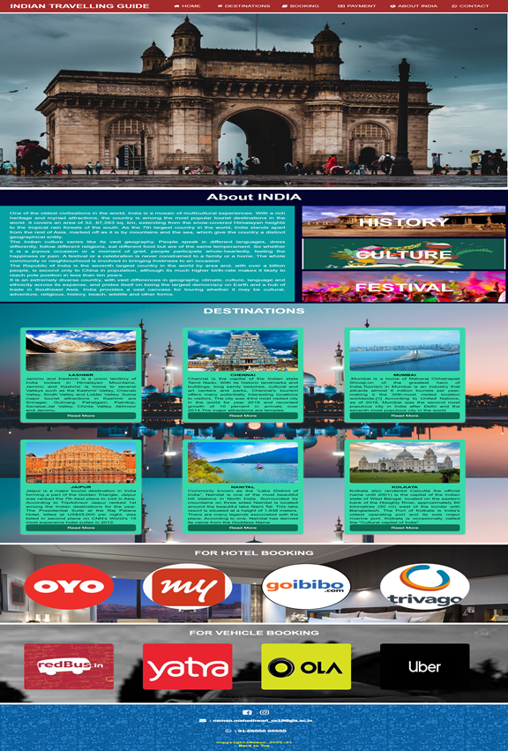

Slide 10
About the Project
In this project, I have made a single page Website that focus on the Front end. The Title of the Website is “Indian Travelling Guide”.
This website is divided into different 5 sections.
1.Section-1 : This is showing Menu bar and Home image
2.Section-2 : This section showing about India and showing links to its culture, history.

Slide 11
About the Project
3.Section-3 : This section is about the hotel bookings, There are different suggestion of sites which offering booking hotel rooms at very attractive price.
4.Section-4 : This section is about vehicle. For example ,if u want a book a cab or u want u book a flight or bus ,there are suggestions for you.
5.Section-5 : This section is about contact, for example if anybody want to contact me, then there are various options like Instagram , facebook etc

Slide 12
About the Project
Navigation Bar: It is the most important part of the website, through this we can reach any section of the website and required links. We have also add smooth scrolling effect. It comprises of
1.Home 2.Destination 3.Booking 4.Payment 5.About India 5.Contact
Booking option is further dived into Hotel Booking and Vehicle Booking
Payment option is further divided into Paytm, Google Pay, Bhim UPI, Phone pe

Slide 13
Advantages
User friendly Interface.
From this website, you know most of the things about Indian culture, its history and festivals which help in while traveling India.
You have come to know about best Indian Destinations ,and the sites which offer hotel rooms at attracting prices and vehicle suggestions also.

Slide 14
Limitations
• This website is not at par with hefty computations of backend systems
• Since it is an online project, customers need internet connection
• People who are not familiar with computers or using online websites can’t use this software
• Heavy traffic leads to failure or long wait issues

Slide 15
Thank
You…

